Slide 1
Presentation tips
Professor Stanworth

Slide 2
Opening
Good morning / Good Afternoon / Good evening
My name is XXX and these are my team members, ZZZ, ZZZZ and ZZZ
The objective of today’s presentation is to introduce the economic and cultural background of YYYY
Today’s presentation will last about 10 minutes
Our agenda is in 5 parts . . .

Slide 3
Use of contrast
What are you saying?
What are you saying?
What are you saying?
What are you saying?
What are you saying?
What are you saying?

Slide 4
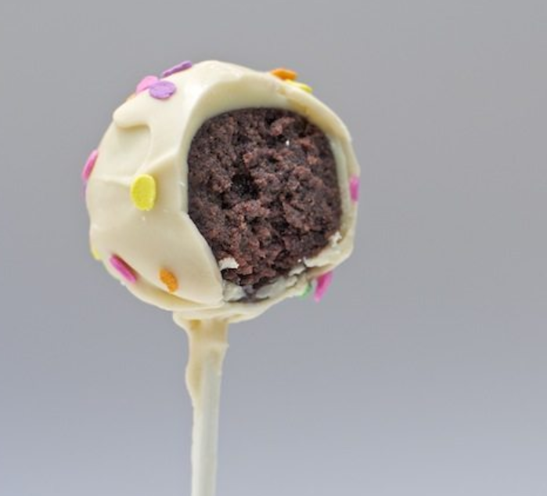
Delicious cake . . . On bite at a time!
Gobble the cake . . . indigestion
Show all the words . . . mental indigestion
More = less communication
Break messages into digestible parts

